Slide 1
Unit – 6 Case Study
By:- Jatin Sethi
jsethi@ddn.upes.ac.in

Slide 2
Case Study1: Mozilla

Slide 3
History of Mozilla
As was the case with Apache's predecessor, it was the NCSA ( NEXTGENERATION COMMUNICATOR SOURCE CODE) where the first complete Internet browser, Mosaic, was "born" in 1993.
The development team, with Marc Andreessen and Jim Clark at the helm, created a small company in order to write, starting from zero (as there were problems with the copyright on the code of Mosaic and the technical design of the program had its limitations.
Netscape Communicator browser, which was, unarguably, the leader of the market of Internet browsers until the arrival of Microsoft Internet Explorer.
Around 1997, Netscape's market share had dropped sharply due to the spread of Microsoft Explorer; consequently, Netscape Inc. was studying new ways of recovering its previous dominance.
In January 1998, Netscape Inc. officially announced that it would publicly release the source code of its browser, marking an extremely important milestone within the short history of free software: a company was going to publish the whole of the source code of an application that had been a commercial product up until then, under a free software license.
The Mozilla project was created in 1998 with the release of the Netscape browser suite source code. At the end of the process, more than one million and a half lines of source code were released.

Slide 4
History of Mozilla
After several years of development, Mozilla 1.0, the first major version, was released in 2002.
The Netscape Public License (NPL) was created: a license that was based on the basic principles of free software licenses, but that also gave certain additional rights to Netscape Inc, which also made it a non-free license, from the perspective of the Free Software Foundation. When the draft of the NPL was published for public discussion, the clause providing additional rights to Netscape was heavily criticised. Netscape Inc. reacted quickly in response to these criticisms and created an additional license, the Mozilla Public License (MPL), which was identical to the NPL, except in that Netscape had no additional rights.
The first version of Phoenix (later renamed to Firefox) was also released by Mozilla community members that year with the goal of providing the best possible browsing experience to the widest possible set of people.
In 2003, the Mozilla project created the Mozilla Foundation, an independent non-profit organization supported by individual donors and a variety of companies.
On 15th July 2003, Netscape Inc. (now the property of America On Line) announced that it was no longer going to develop the Netscape browser
Firefox 1.0 was released in 2004 and became a big success — in less than a year, it was downloaded over 100 million times.
In 2013, Firefox OS was launched to unleash the full power of the Web on smartphones and once again offer control and choice to a new generation of people coming online.
Mozilla also celebrated its 15th anniversary in 2013.

Slide 5
More about Mozilla
The Mozilla project hosts various independent applications, the most notable of which include Mozilla Firefox (web browser), which is undoubtedly the most well-known, Mozilla Thunderbird (email and news client), Mozilla Sunbird (calendar), Mozilla Nvu (HTML editor), Camino (web browser designed for Mac OS X) and Bugzilla (web-based bug-tracker tool).

Slide 6
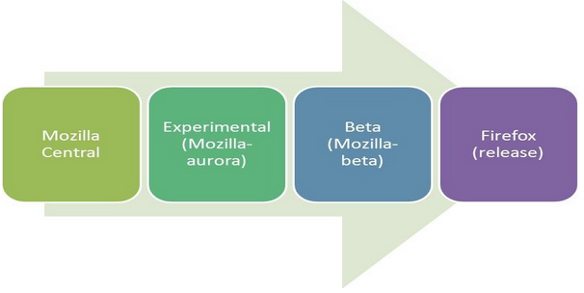
Mozilla Development Process
Mozilla uses schedule-driven process, meaning the release happens regardless of whether a given feature is ready or not.
All changes to source code are collated here.
All the features which have passed the experimental stage are incorporated into beta release
Mozilla-aurora is frequented with many features at regular intervals and they are tested, if they fail to work they are disabled. Features that are disabled or miss the schedule are pulled again in the next schedule cycle.

Slide 7
Case Study 2: Linux

Slide 8
Linux istory
In 1990, Richard Stallman visited Polytechnic University in Helsinki, Finland to voice the philosophy of free software movement.
Among the audience was a 21 year old Linus Torvalds, future developer of Linux Kernel, liked the idea of sharing the code.
During 1991, Torvalds took the Minix operating system and rewrote it by adding features and released it as a first version of Linux.
During January 1992 Torvalds decided to adopt the GPL as a standard license for Linux. This was a major decision that Torvalds made.
He chose it because it’s already proved by the community. He knew that this will remove the restriction on charging for distribution costs, but it also invoked the GPL “viral” clause, which ensured that any new software built with Linux code would have to be released with source code under the GPL as well and would remain free code forever and no proprietary organizations can use it for their profit.
The operating system has been improvised since its inception by the contributions of the open source community.
Torvalds became the chief architect of the Linux Kernel and now acts a project’s coordinator for Linux Kernel development.

Slide 9
LINUX Distribution
Linux quickly evolved from a single-person project to a world-wide development project involving thousands of developers.
One of the most important decisions for Linux was its adoption of the GNU General Public License (GPL).
This prohibited the misuse of the source code by the commercial vendors and nurtured the open source community for its rapid development.
A typical Linux distribution comprises of linux kernel and many application programs and tools along with documentation
Many system level and user level tools found in a Linux distribution come from Free Software Foundation’s GNU project. Both the linux kernel and the GNU suite of applications are released under the GNU General Public License (GPL).
Linux distributions have taken multiple forms – fully featured desktop, server , mobiles and laptops. There are two categories of distributions:
Commercially backed – Fedora (Red Hat), openSUSE (Novell), Ubuntu(Canonical Ltd.) and Mandriva Linux(Mandriva)
Community driven – Debian and Gentoo

Slide 10
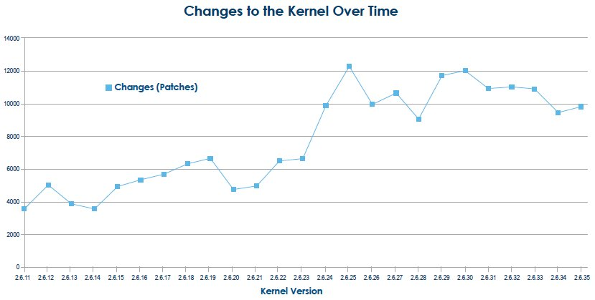
Change Rate
The Linux kernel which forms the core of the Linux operating system is a result of contributions from over 1000 developers and 200 corporations.
The rate of change in the kernel is increasing rapidly
On an average there are 4 to 5 patches applied to the kernel tree per hour.
when a new kernel is released, defects will be reported and patches will be released that contains the fix for the problem.

Slide 11
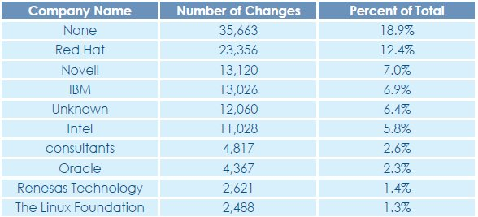
Kernel Development
There are over 1000 developers and 200 corporations who are sponsoring the work of the linux kernel development with the significant contributions being made from the individual developer community.
The Pareto principle, well known as the 80-20 rule is applicable to the contributions made by developer community.
Even though there are over 1000 developers, top 10 developers have contributed to the 10% of the total changes and top 30 developers have contributed towards 22% of the total changes.
The snapshot shows the top 10 contributors making 70% of the total changes to the kernel
The “None” category represent individuals that are doing the kernel development work on their own interest without the financial benefit from any organization.
The “Unknown” category represents developers whose corporate affiliation cannot be determined.

Slide 12
Why Companies Support Kernel Development?
Firms have their own self interests in supporting the kernel development of Linux because it provides competitive edge in the markets.
Companies like IBM, Intel etc., are working to ensure that Linux runs and performs well on their hardware enabling increased sales on the offerings that are linux based.
Distributors like RedHat and Novell have clear interests in making Linux kernel better and robust.
Companies like Sony and Nokia are working because they ship linux as a component of products in mobiles, television sets etc.,

Slide 13
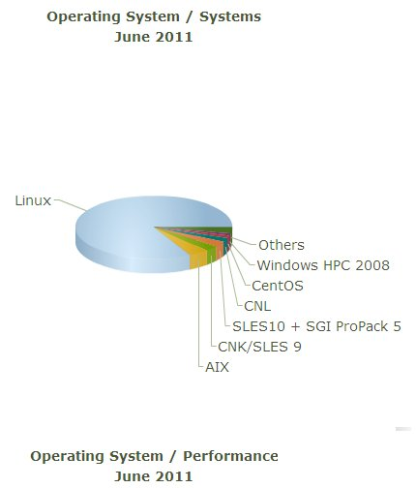
Linux Dominance in the Industry
Linux is no more limited to being a desktop operating system.
It has made its way to the production environment across multiple industry verticals like Chemical and Petroleum, Education, Finance and so on.
The data (shown left) from Top500.org which shows the dominance of Linux in the Super Computing industry.
June 2011
Results
The Linux operating system is one of the largest and most successful open source projects that has proven open source development model is effective.
The sheer quantum of developers contributing towards the improvement of Linux and the rate at which changes are incorporated is remarkable in the technological realm.

Slide 14
Various Linux Distributions (Some Examples)
RPM Based
Fedora Based
EduLinux
RHEL Based
CentOS
ClearOS
Miracle Linux
Berry Linux
openSuse Based
Linkat
SUSE Desktop
SUSE Server
Debian Based
Knoppix Based
Feather Linux
Damn Small Linux
Ubuntu Based
Ubuntu GNOME
Ubuntu MATE
Lubuntu
Xubuntu
PacMan Based
Chakra Linux
Arch Based
ArchBang
Manjaro
Antergos
Gentoo Based
Gentoox
Ututo
CoreOS
Funtoo

Slide 15
Linux Shell
The shell is a user program or it is an environment provided for user interaction.
The shell accepts human readable commands and translates them into something the kernel can read and process.
It is a command language interpreter that executes commands read from the standard input device such as keyboard or from a file.
The shell gets started when you log in or open a console (terminal).
Quick and dirty way to execute utilities.
The shell is not part of system kernel, but uses the system kernel to execute programs, create files etc.
Several shells are available for Linux including:
BASH ( Bourne-Again SHell ) - Most common shell in Linux. It's Open Source.
CSH (C SHell) - The C shell's syntax and usage are very similar to the C programming language.
KSH (Korn SHell) - Created by David Korn at AT & T Bell Labs. The Korn Shell also was the base for the POSIX Shell standard specifications.
TCSH - It is an enhanced but completely compatible version of the Berkeley UNIX C shell (CSH).

Slide 16
Identify your shell
echo $SHELL ps $$ ps -p $$
echo $SHELL
ps $$
cat /etc/shells

Slide 17
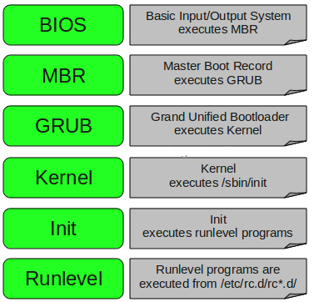
Linux Booting

Slide 18
Linux Booting (in Detail)
1. BIOS
BIOS stands for Basic Input/Output System
Performs some system integrity checks
Searches, loads, and executes the boot loader program.
It looks for boot loader in floppy, cd-rom, or hard drive. You can press a key (typically F12 of F2, but it depends on your system) during the BIOS startup to change the boot sequence.
Once the boot loader program is detected and loaded into the memory, BIOS gives the control to it.
So, in simple terms BIOS loads and executes the MBR boot loader.
2. MBR
MBR stands for Master Boot Record.
It is located in the 1st sector of the bootable disk. Typically /dev/hda, or /dev/sda
MBR is less than 512 bytes in size. This has three components 1) primary boot loader info in 1st 446 bytes 2) partition table info in next 64 bytes 3) mbr validation check in last 2 bytes.
It contains information about GRUB (or LILO in old systems).
So, in simple terms MBR loads and executes the GRUB boot loader.

Slide 19
Linux Booting (in Detail)
3. GRUB
GRUB stands for Grand Unified Bootloader.
If you have multiple kernel images installed on your system, you can choose which one to be executed.
GRUB displays a splash screen, waits for few seconds, if you don’t enter anything, it loads the default kernel image as specified in the grub configuration file.
GRUB has the knowledge of the filesystem (the older Linux loader LILO didn’t understand filesystem).
Grub configuration file is /boot/grub/grub.conf (/etc/grub.conf is a link to this). The following is sample grub.conf of CentOS.
#boot=/dev/sda default=0 timeout=5 splashimage=(hd0,0)/boot/grub/splash.xpm.gz hiddenmenu title CentOS (2.6.18-194.el5PAE) root (hd0,0) kernel /boot/vmlinuz-2.6.18-194.el5PAE ro root=LABEL=/ initrd /boot/initrd-2.6.18-194.el5PAE.imgAs you notice from the above info, it contains kernel and initrd image.
So, in simple terms GRUB just loads and executes Kernel and initrd images.
4. Kernel
Mounts the root file system as specified in the “root=” in grub.conf
Kernel executes the /sbin/init program
Since init was the 1st program to be executed by Linux Kernel, it has the process id (PID) of 1. Do a ‘ps -ef | grep init’ and check the pid.
initrd stands for Initial RAM Disk.
initrd is used by kernel as temporary root file system until kernel is booted and the real root file system is mounted. It also contains necessary drivers compiled inside, which helps it to access the hard drive partitions, and other hardware.

Slide 20
Linux Booting (in Detail)
5. Init
Looks at the /etc/inittab file to decide the Linux run level.
Following are the available run levels
0 – halt
1 – Single user mode
2 – Multiuser, without NFS
3 – Full multiuser mode
4 – unused
5 – X11
6 – reboot
Init identifies the default initlevel from /etc/inittab and uses that to load all appropriate program.
Execute ‘grep initdefault /etc/inittab’ on your system to identify the default run level
If you want to get into trouble, you can set the default run level to 0 or 6. Since you know what 0 and 6 means, probably you might not do that.
Typically you would set the default run level to either 3 or 5.

Slide 21
Linux Booting (in Detail)
6. Runlevel programs
When the Linux system is booting up, you might see various services getting started. For example, it might say “starting sendmail …. OK”. Those are the runlevel programs, executed from the run level directory as defined by your run level.
Depending on your default init level setting, the system will execute the programs from one of the following directories.
Run level 0 – /etc/rc.d/rc0.d/
Run level 1 – /etc/rc.d/rc1.d/
Run level 2 – /etc/rc.d/rc2.d/
Run level 3 – /etc/rc.d/rc3.d/
Run level 4 – /etc/rc.d/rc4.d/
Run level 5 – /etc/rc.d/rc5.d/
Run level 6 – /etc/rc.d/rc6.d/
Please note that there are also symbolic links available for these directory under /etc directly. So, /etc/rc0.d is linked to /etc/rc.d/rc0.d.
Under the /etc/rc.d/rc*.d/ directories, you would see programs that start with S and K.
Programs starts with S are used during startup. S for startup.
Programs starts with K are used during shutdown. K for kill.
There are numbers right next to S and K in the program names. Those are the sequence number in which the programs should be started or killed.
For example, S12syslog is to start the syslog deamon, which has the sequence number of 12. S80sendmail is to start the sendmail daemon, which has the sequence number of 80. So, syslog program will be started before sendmail.

Slide 22
Building the Linux Kernel
Configuring the Kernel
Compiling the Kernel
Installing the Kernel
Clean Linux Source and Config file

Slide 23
Linux Installation – Minimum Requirements
Minimum Requirements for common Linux distributions:
700 MHz processor (about Intel Celeron or better)
512 MiB RAM (system memory)
5 GB of hard-drive space (or USB stick, memory card or external drive but see LiveCD for an alternative approach)
VGA capable of 1024x768 screen resolution
Either a CD/DVD drive or a USB port for the installer media
Internet access is helpful

Slide 24
Linux Installation – Partitioning
For a healthy Linux installation, three partitions are recommended:
swap
This is space on the hard drive that can be used as virtual memory. Virtual memory allows computer to run large programs and perform complex tasks even if it does not have enough physical RAM to do the job.
One swap partition is usually 50% to 100% the size of the physical RAM in your system
root (/)
The root file system is represented by a forward slash (/). It is the top of the directory tree, and contains Linux and everything that you install with Linux.
This is roughly equivalent to “C:”
Usually a minimum root partition is between 2GB and 8GB.
/home
The place where all the user-specific files, data in other words, are stored.
It is roughly equivalent to the “My Documents” folder

Slide 25
Linux Installation – Common Problems
Use of bad ISO
Network Adapter settings in VM while installing Linux in VM
Allocating less than 50% memory to swap partition
Incomplete knowledge about Linux Partitions
Forgetting to update the list of available packages
Resizing of a Windows partition to accommodate Linux for parallel installation

